Slide 1

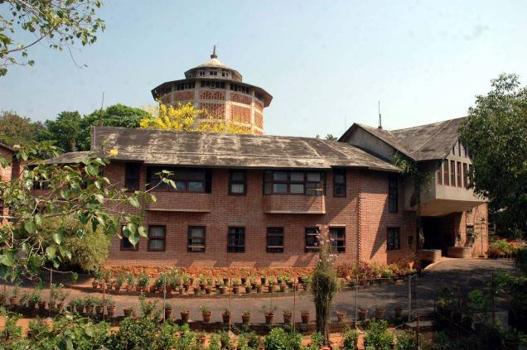
Kautilya Conference
3-5 October 2025, New Delhi
Democracy and Prudence (Interactive Session 3A)
The State of State Finances
Sudipto Mundle

Slide 2
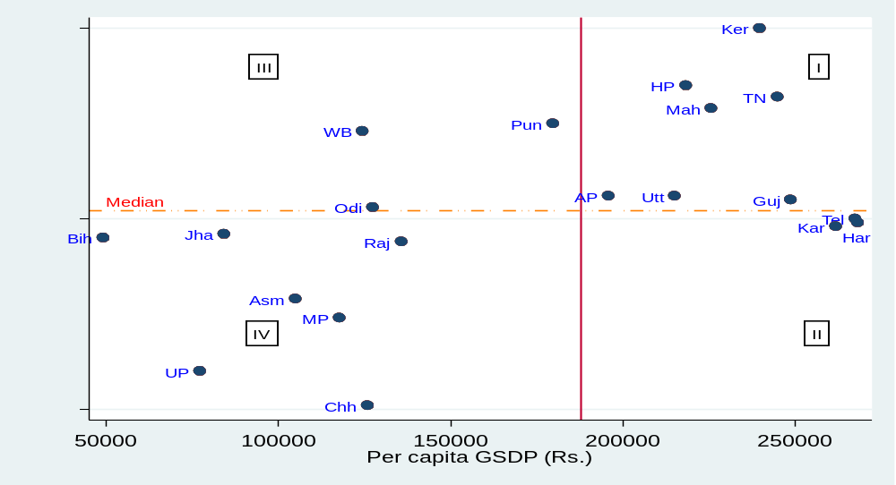

Bivariate Classification of states by per capita income and longevity
I. Balanced Development (BD) states: >median per capita income; > median longevity
II. Economic Growth (EG) oriented states: >median per capita income; < median longevity
III. Social Development (SD) oriented states: <median per capita income; > median longevity
IV. Lagging (L) states: <median per capita income <median longevity
Goal is to move all states towards top right direction (Quadrant I).

Slide 3
Fiscal Performance Indictors of States: 2022-23
 |  | Per capita Totex | ORR/ TRR (%) | Capex/Totex (%) | Social Service expd/ Totex (%) | FD/ GSDP (%) | Debt/ GSDP (%)
A | Balanced development states (BD) Average | 38533 | 66.1 | 11.7 | 37.1 | -2.4 | 24.9
1 | Andhra Pradesh | 39281 | 52.9 | 3.5 | 42.6 | -4.0 | 32.0
2 | Gujarat | 30224 | 71.8 | 16.5 | 40.9 | -0.8 | 18.5
3 | Himachal Pradesh | 67696 | 35.4 | 11.9 | 38.4 | -6.5 | 45.2
4 | Kerala | 44091 | 65.6 | 9.0 | 34.2 | -2.4 | 36.8
5 | Maharashtra | 37165 | 72.5 | 13.1 | 36.8 | -1.9 | 18.7
6 | Tamil Nadu | 41620 | 68.6 | 12.4 | 32.3 | -3.5 | 29.2
7 | Uttarakhand | 44850 | 43.7 | 15.8 | 38.8 | -1.0 | 25.8
B | Economic Growth Oriented States (EG) Average | 41542 | 74.5 | 15.5 | 35.8 | -2.4 | 26.1
8 | Haryana | 39568 | 80.4 | 9.9 | 40.2 | -3.2 | 31.0
9 | Karnataka | 40425 | 68.8 | 21.0 | 34.3 | -2.1 | 23.5
10 | Telangana | 45077 | 79.4 | 10.4 | 35.2 | -2.5 | 26.9
C | Social Development Oriented States (SD) Average | 29867 | 51.6 | 11.7 | 41.4 | -3.3 | 34.2
11 | Odisha | 35609 | 59.3 | 20.3 | 37.2 | -2.0 | 14.9
12 | Punjab | 37304 | 55.3 | 5.5 | 27.3 | -5.0 | 46.5
13 | West Bengal | 24761 | 43.9 | 9.0 | 51.3 | -3.3 | 38.2
D | Lagging States (L) Average | 23345 | 44.1 | 15.7 | 39.8 | -3.4 | 31.0
14 | Assam | 33118 | 33.7 | 13.6 | 46.3 | -5.8 | 25.3
15 | Bihar | 17104 | 27.9 | 14.6 | 43.8 | -6.0 | 39.0
16 | Chhattisgarh | 32828 | 51.5 | 13.5 | 37.3 | -1.0 | 21.9
17 | Jharkhand | 20555 | 47.3 | 17.4 | 40.7 | -1.2 | 30.1
18 | Madhya Pradesh | 28362 | 45.4 | 18.2 | 39.6 | -3.3 | 29.2
19 | Rajasthan | 30532 | 55.3 | 8.0 | 40.2 | -3.7 | 37.0
20 | Uttar Pradesh | 20154 | 45.0 | 19.7 | 36.8 | -2.9 | 28.9
Totex: Total expenditure per capita; ORR: Own revenue receipt; TRR: Total revenue receipt; GSDP: Gross state domestic product;
Capex: Capital expenditure; FD: Fiscal deficit. Debt: outstanding liabilities.
Notes:
Huge variations in per capita state spending L states average Rs. 23345 to GD states average Rs. 41542. For individual states per capita spending ranges from Bihar (Rs. 17104) to H.P (Rs. 67696), almost 5 times.
High income (HI) states (EG + BD) have much higher ORR (60 to 80%) compared to low income (LI) states (L + SD): 34 to 55%. Outliers: Himachal (35%) & Uttarakhand (44%) among BD states, Orissa (59%) among SD states
Low income (LI) states have higher FD (3.4%) and higher debt:GDP ratio compared to 2.4% FD and 25% debt:GDP for high income (HI) states. Outliers Chhatisgarh (1.2%) and Jharkhand (1.2%) among LI states and Himachal FD (6.3%) among HI states
Quality of expenditure comparable for HI and LI states. Capex and social spending shares in totex similar.

Slide 4
Key take aways from inter-state comparisons of economic development, social development and fiscal performance
Low income states caught in a trap of low ORR, higher fiscal deficit and high indebtedness, yet much lower public spending per capita.
Allocation of expenditure in terms of shares of capex and social spending already similar to high income states. What can they do?
Best way for LI states to boost per capita income and social development is to significantly improve spending efficiency
This can be attempted through Two Tier performance linked support
- At state level conditional cash transfers (CCT) to households
e.g. income support linked to children’s school attendance
- At federal level Centrally Sponsored Scheme (CSS) support for states adopting CCT approach in priority program.
A good example of this with lessons for India is the Bolsa Familia program in Brazil.

Slide 5
Thank you…

