Slide 1

IIFT ECONOMICS CONCLAVE 2025
NEW DELHI
5 December 2025
India in the New Economic Order: Adapting to Macroeconomic Uncertainties and Global Trade Shocks
[based on NIPFP Mid-Year Macroeconomic review]
Sudipto Mundle
Chairman, Centre for Development Studies
India

Slide 2
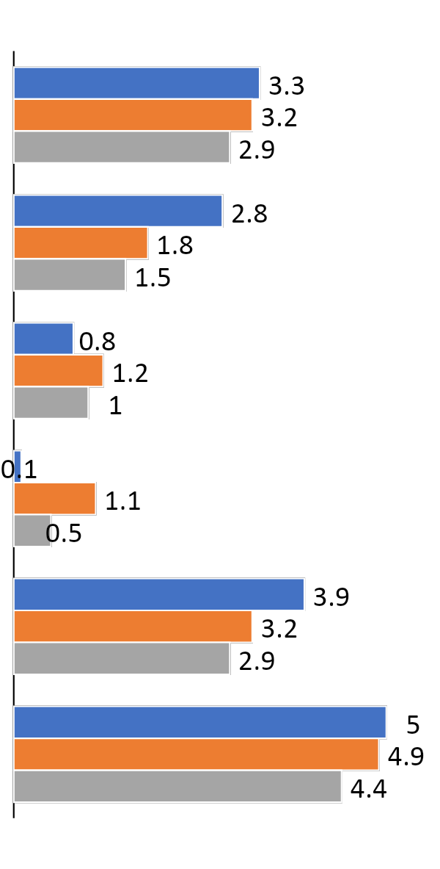
Global growth remained resilient in 2025, expected to moderate in 2026
2024
2025P
2026P
GDP GROWTH, %
POSITIVE DRIVERS
NEGATIVE DRIVERS
Front-loading in trade and production to pre-empt tariff hike
Massive investment in AI technology in US, China, Japan
Fiscal & monetary stimulus in many countries
Successful trade diversification
US tariff shock
War in Ukraine and Gaza
Weakening consumption demand and low consumer confidence
Continuing property sector crisis in China
Unemployment rising in US, curtailed immigration
World
U.S.
Euro
Area
Japan
BRICS
China
SOURCE: OECD, interim estimates, September 2025

Slide 3
India: External Sector

Slide 4
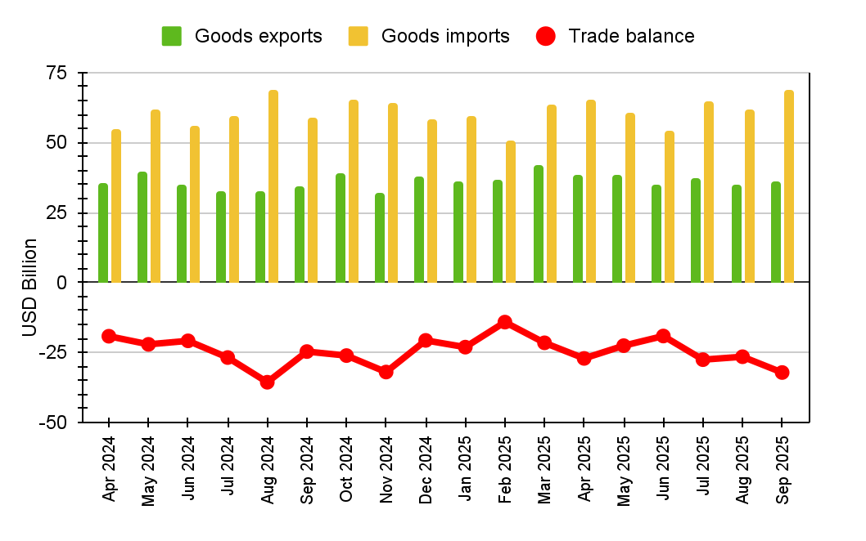
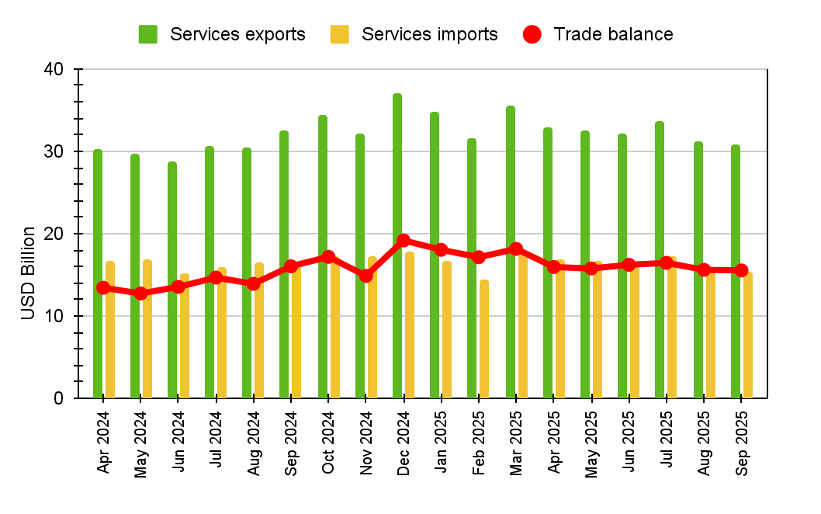
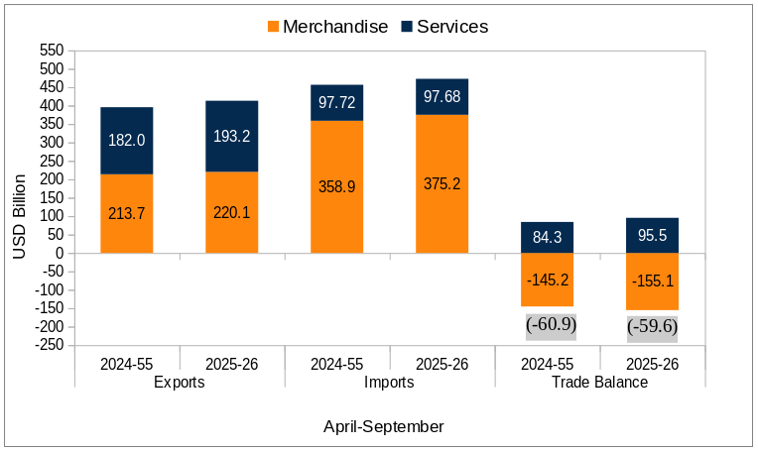
Merchandise exports growth slowing down
In September 2025, growth in merchandise imports surpassed growth in exports.
  Imports grew by around 16.6% (Y-o-Y) to USD 68.5 billion.
  Exports rose by only around 6.7% to USD 36.4 billion.
Services: Both imports and exports contracted, with the contraction in imports surpassing that of exports.
  Services exports contracted by 5.4% in September to USD 30.8 billion.
  Services imports contracted by 7.6% to USD 15.3 billion
For April-September, India’s total exports (goods and services) posted a growth of 4.43% while total imports registered a growth of 3.57%, entailing a contraction in trade deficit to USD 59.6 billion.
Source: Ministry of Commerce & Industry

Slide 5
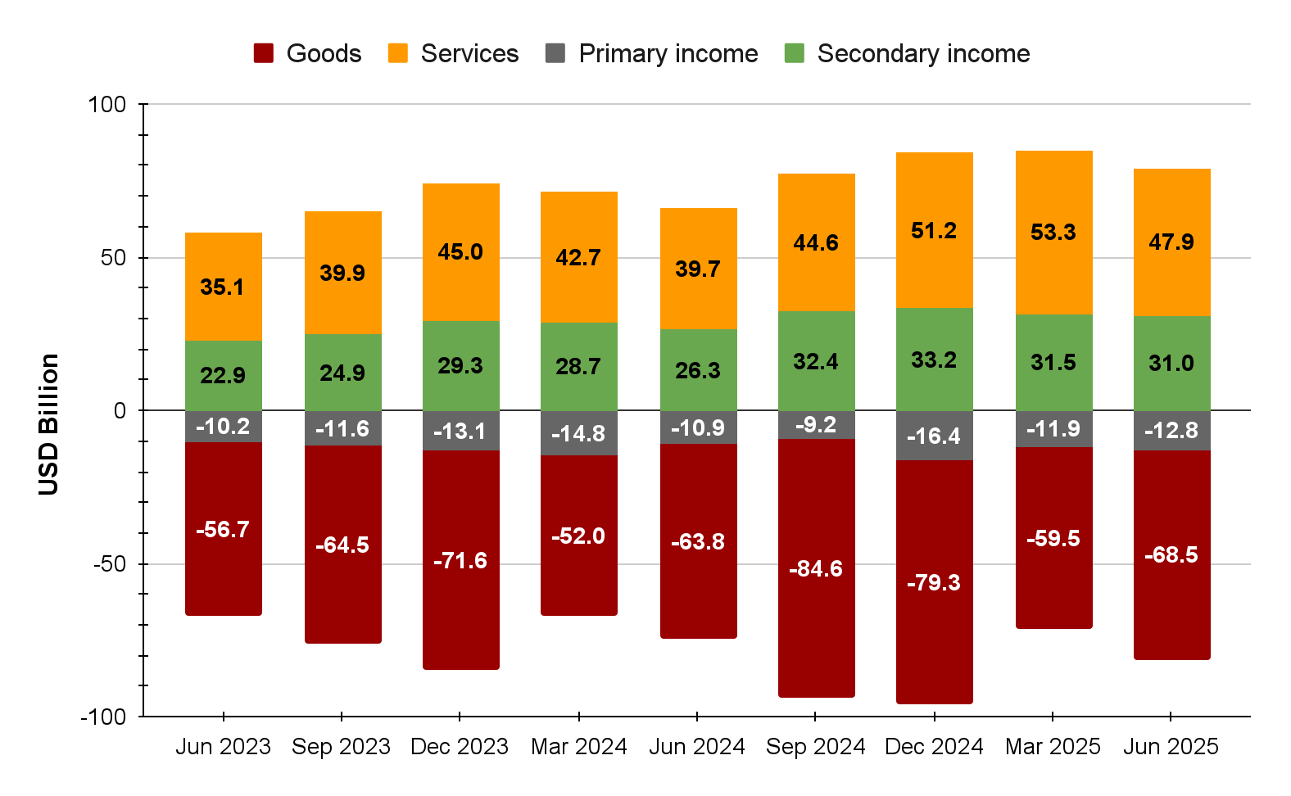
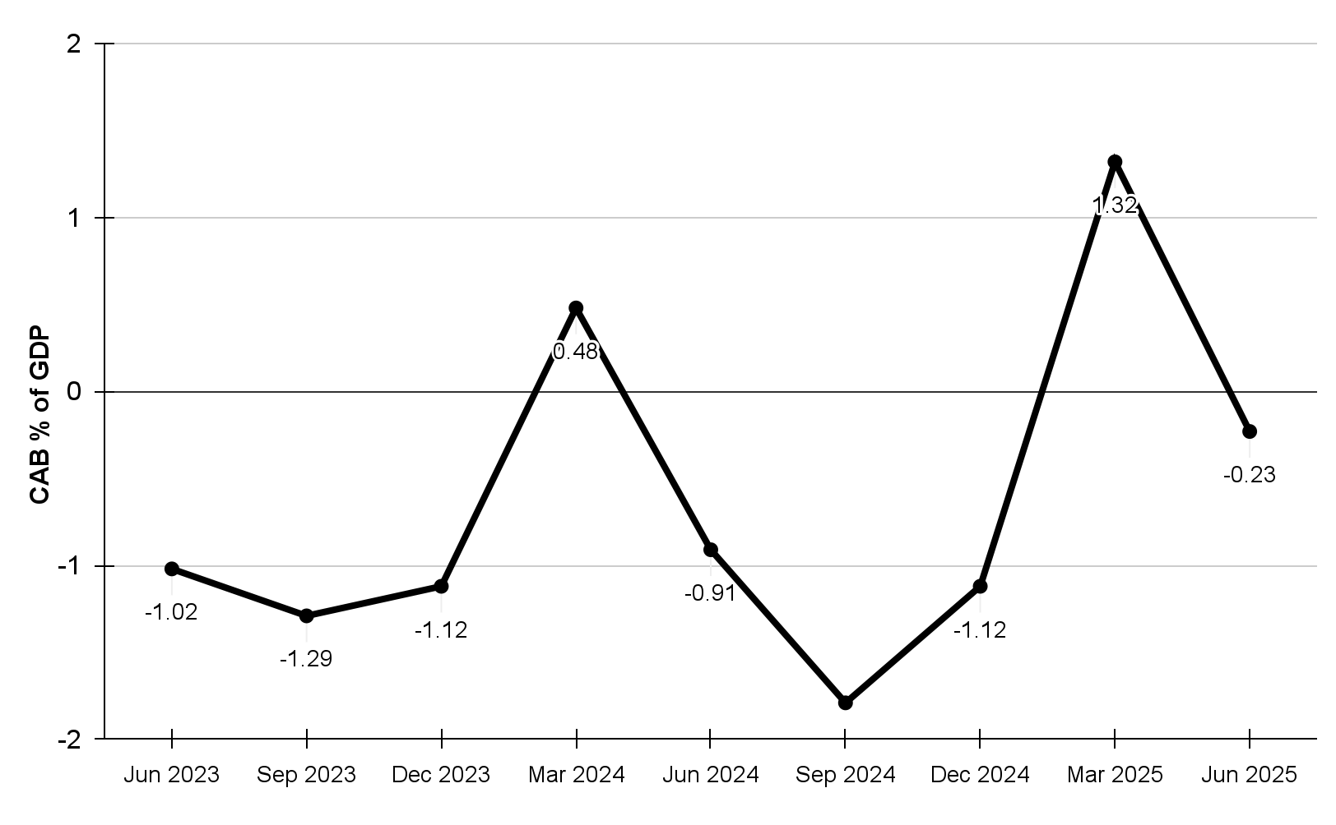
Current account balance turned negative due to rise in merchandise deficit
Source: RBI
Merchandise trade deficit widened, due to higher imports in non-crude oil & non-gold & silver.
Surplus on service trade improved.
Secondary income improved due to higher remittances by Indians employed overseas.

Slide 6
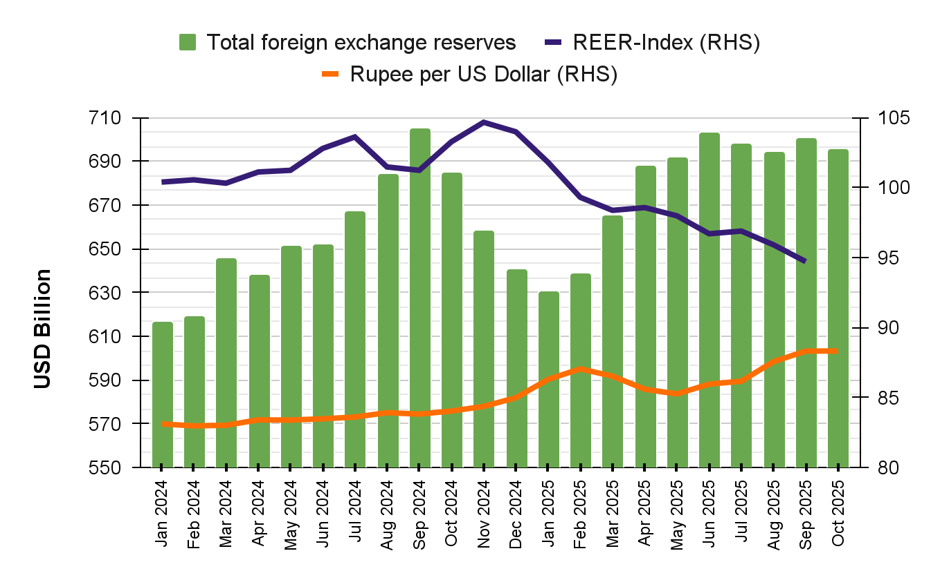
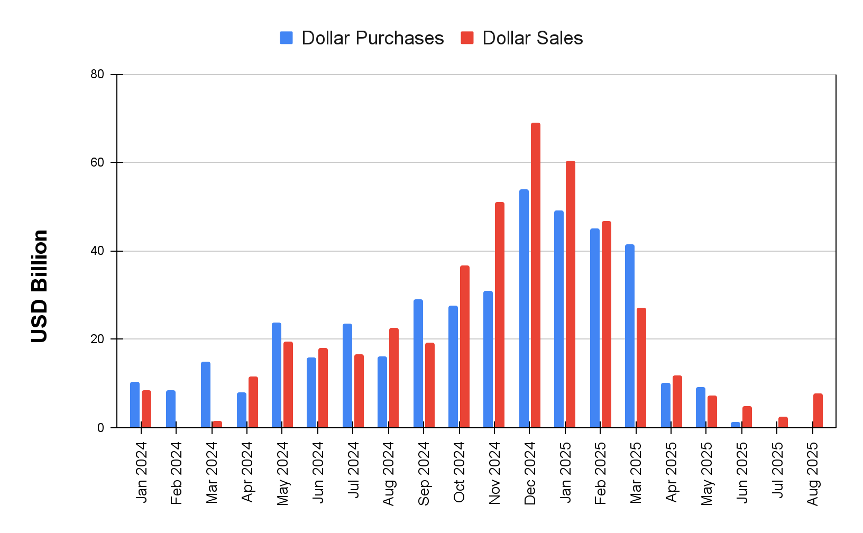
Rupee has weakened as RBI has reduced forex interventions, rising gold reserves
Widening trade deficit, elevated US yields, and sustained capital outflows depreciating rupee
RBI intervention in the forex market has also moderated
Forex reserves have stayed around USD 700 billion.
  Increase in gold reserves from around USD 84 billion to USD 95 billion from April to Sep 2025
Source: RBI & BIS

Slide 7
Structure of India’s Foreign Trade

Slide 8
Export share for India’s top 10 sectors by destination
Apr-Sep 2025, USD Bn
Engineering Goods
Petroleum Products
Electronic Goods
Drugs & Pharma
Gems & Jewellery
Textiles (RMG)
Cotton & Handloom
Plastics & Linoleum
Country
Rice
USA
18%
8%
56%
32%
19%
33%
3%
25%
16%
16%
UAE
7%
10%
10%
1%
33%
8%
4%
2%
3%
6%
Netherlands
2%
20%
3%
2%
0%
5%
1%
1%
4%
1%
China
2%
5%
5%
1%
0%
0%
1%
2%
6%
4%
UK
4%
2%
2%
3%
3%
9%
2%
2%
1%
3%
RoW
68%
55%
24%
61%
45%
44%
88%
67%
69%
70%
SOURCE: DGCSI

Slide 9
India has little leverage vis-à-vis U.S. and high services exposure
Most bilateral trade deals primarily benefit the U.S.
Unlike some other countries, India holds very little leverage
The 10-year defence pact is expected to boost U.S. weapon exports to India
More than half of India’s service exports is to U.S. (3% of GDP)
The U.S. has increased H-1B visa fees to USD 1,00,00
The proposed HIRE Act seeks to impose a 25% outsourcing tax on the largely non-diversified Indian services sector
Notes:
Global growth was more resilient than anticipated in the first half of 2025, especially in many emerging-market economies. Industrial production and trade were supported by front-loading ahead of higher tariffs. Strong AI-related investment boosted outcomes in the United States and fiscal support in China outweighed the drag from trade headwinds and property market weakness. declining
job openings as a share of the unemployed in some economies, including the United States.
Negative drivers- weakening consumption demand in major economies like U.S., Euro Area, China
Geopolitical uncertainties for the euro area include the Russia-Ukraine war, US-China trade tensions, and potential instability from populist political shifts, which weaken economic growth and monetary policy effectiveness. These risks can lead to supply chain disruptions, inflation, and reduced business and consumer confidence, making it more difficult for businesses and households to react to changes in interest rates.
Many emerging-market economies had upside growth surprises but in some cases this reflected idiosyncratic factors that are not expected to continue, including a first
quarter spike in agriculture production in Brazil, and in the second quarter a steep fall in the growth of the GDP deflator in India, significant stockbuilding in Türkiye, and a marked rebound in investment in
Indonesia. In China, growth has held up, with a pick-up in the pace of government spending more than offsetting the dampening influence of the ongoing property market adjustment and headwinds to trade with the United States.
Trade continued to expand steadily in advanced Asian economies in the second quarter, as well as in emerging-market economies in both Asia and Eastern Europe, but import volumes declined sharply in the United States and exports dropped in Canada and Latin America. Bilateral trade between China and the United States has declined sharply in recent months.
Industrial production has fallen in recent months in several countries, such as Korea, Germany and Brazil.
While the unemployment rate has increased in South Africa, India, Canada, France, Australia, Germany and the United States, it has fallen in other countries, most notably Korea, Türkiye, Brazil, Italy and Spain and reached a historical low in the euro area.

Slide 10

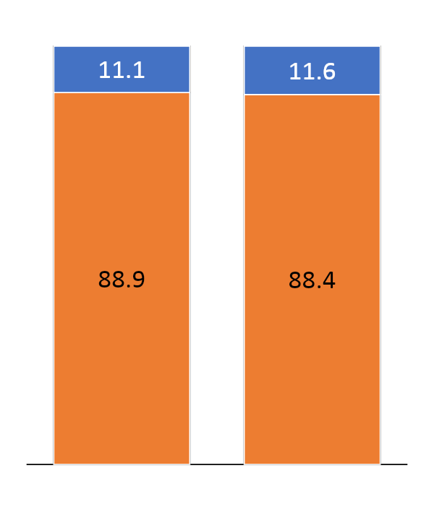
Key Insights from India’s Trade Story
Global trade, %
Key insights
US
Rest of the world
Almost 90% of global trade is independent of U.S.
Almost 80% of Indian exports independent of U.S.
U.S. Imports from India highly concentrated in few sectors: Electronics, Drugs & Pharma, Textiles, Services
Policy Priority : diversification
Merchandise Exports important, but real risk is high exposure of services sector to U.S.
Services export diversification most urgent
Merchandise
Services

Slide 11
Growth

Slide 12
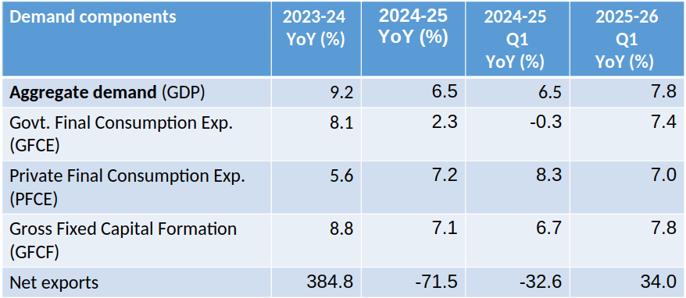
Aggregate demand growth in Q1 2025-26 has been broad based
Trade Deficit

Slide 13
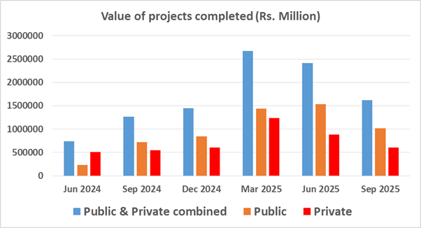
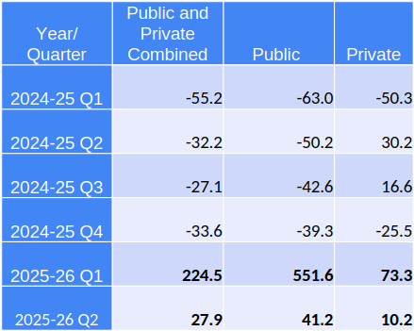
Growth mainly driven by robust public sector investment
Source: CMIE CAPEX

Slide 14
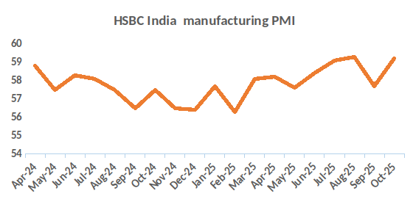
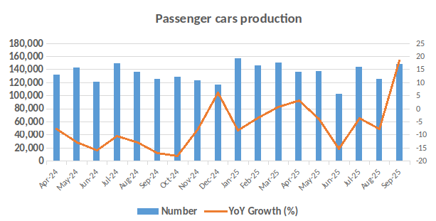
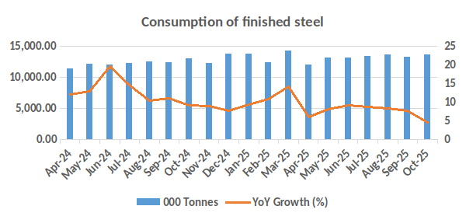
Industrial performance outlook mixed for FY 26
Performance of passenger cars sector picked up in pre-festive time
Construction sector growth moderated in the beginning of H2 FY26
57% growth in Value of new orders for machineries, while it contracted by 11% in infrastructure sector

Slide 15
Alternative growth Scenarios for FY 26 (with GST restructuring & tariff shock impacts)
GDP growth forecast at 6.0—8.8% for FY 25-26
Baseline | Optimistic View: Effective GST rate declines by 1%; US output 1% above potential | Pessimistic View: Effective GST rate declines by 1%; US output 1% below potential | Effective GST rate declines by 1%; US output near the potential
7.1 | 8.8 | 6 | 7.4
Source: : Authors’ estimates

Slide 16
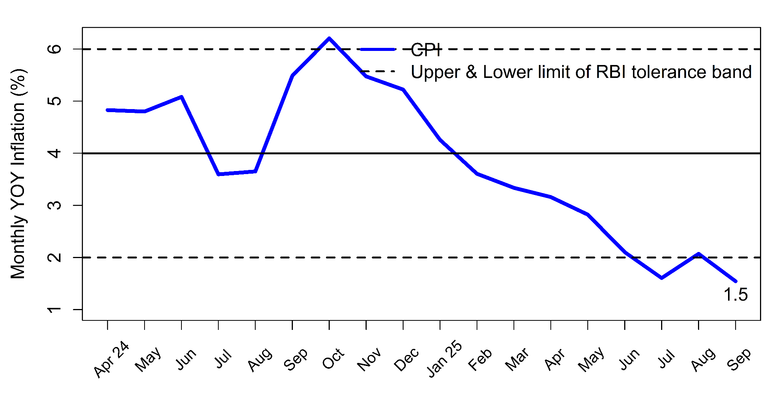
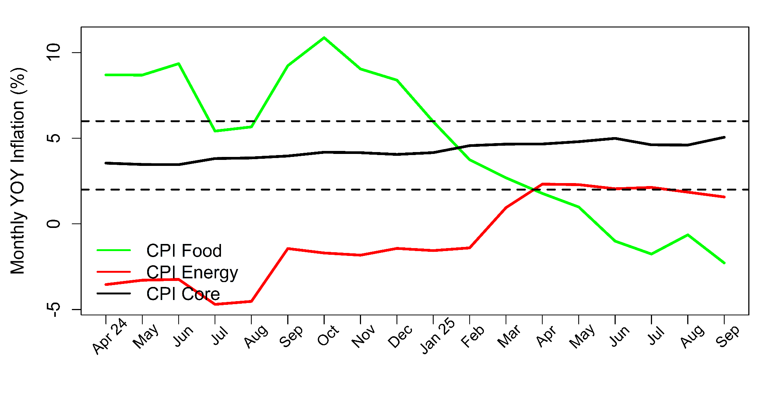
Headline inflation well below 4% target on account of moderating food and energy inflation, while core inflation rising
Source: CSO
CPI food inflation moderating due to deflation in most of food items, mainly on account of Vegetable and Pulses prices, while Edible oil inflation is high.
CPI Core inflation on rise due to high and rising inflation rates in gold and silver prices.

Slide 17
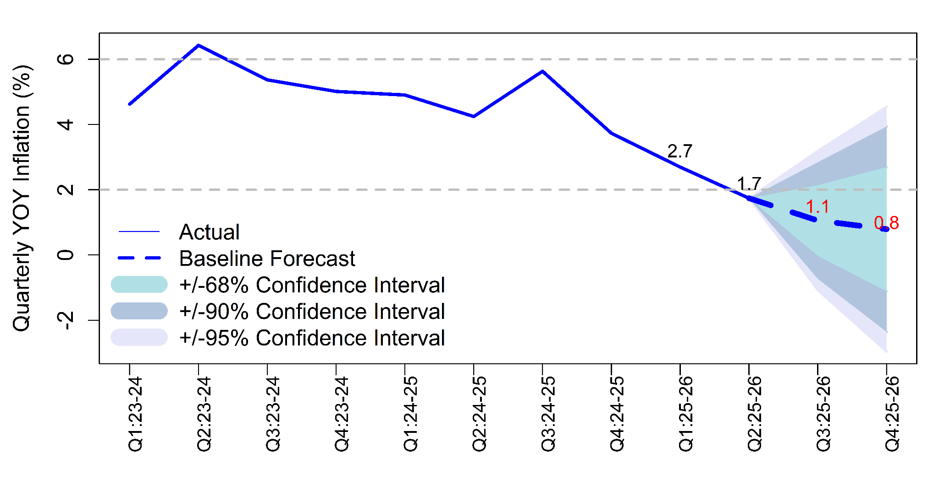
Inflation forecast for FY 26 benign at 1.6%
Our inflation projection for 2025-26 is 1.6%
  1.1% in Q3, 0.8% in Q4
Upside risk: Buoyant domestic demand propelled by GST rate restructuring
Downward factor: Trump shock to act as a negative demand shock, & moderating energy inflation
RBI forecasts: FY 2025-26: 2.6%, 1% higher than ours;
  RBI forecasts: FY 2025-26: 2.6%, 1% higher than ours;
  1.8% & 4% for FY26 Q3 and Q4
Source: CSO, Bhattacharya & Kapoor, 2020

Slide 18
Thank you

